Slide 1
CAP442 Web Technology
Unit I
Session 8
II Year M.C.A

Slide 2
Contents
Cascading Style Sheets(CSS)
CSS Properties
Colors
Size (Height & Width)
Padding & Margin
Borders

Slide 3
Colors
Colors in CSS can be specified by the following methods:
Hexadecimal colors
Hexadecimal colors with transparency
RGB colors
RGBA colors
HSL colors
HSLA colors
Predefined/Cross-browser color names
With the currentcolor keyword

Slide 4
Hexadecimal colors
A hexadecimal color is specified with: #RRGGBB,
Here the RR (red), GG (green) and BB (blue) hexadecimal integers specify the components of the color.
All values must be between 00 and FF.
#p1 {background-color: #ff0000;} /* red */ #p2 {background-color: #00ff00;} /* green */ #p3 {background-color: #0000ff;} /* blue */

Slide 5
Hexadecimal Colors With Transparency
A hexadecimal color is specified with: #RRGGBB.
To add transparency, add two additional digits between 00 and FF.
#p1a {background-color: #ff000080;} /* red transparency */ #p2a {background-color: #00ff0080;} /* green transparency */ #p3a {background-color: #0000ff80;} /* blue transparency */

Slide 6
RGB Colors
An RGB color value is specified with the rgb() function, which has the following syntax:
rgb(red, green, blue)
Each parameter (red, green, and blue) defines the intensity of the color and can be an integer between 0 and 255 or a percentage value (from 0% to 100%).
the following values define equal color: rgb(0,0,255) and rgb(0%,0%,100%).
#p1 {background-color: rgb(255, 0, 0);} /* red */

Slide 7
RGBA Colors
RGBA color values are an extension of RGB color values with an alpha channel - which specifies the opacity of the object.
An RGBA color is specified with the rgba() function, which has the following syntax:
rgba(red, green, blue, alpha)
The alpha parameter is a number between 0.0 (fully transparent) and 1.0 (fully opaque).
#p2 {background-color: rgba(0, 255, 0, 0.3);} /* green with opacity */

Slide 8
HSL Colors
HSL stands for hue, saturation, and lightness - and represents a cylindrical-coordinate representation of colors.
An HSL color value is specified with the hsl() function, which has the following syntax:
hsl(hue, saturation, lightness)

Slide 9
Hue is a degree on the color wheel (from 0 to 360) - 0 (or 360) is red, 120 is green, 240 is blue.
Saturation is a percentage value; 0% means a shade of gray and 100% is the full color. Lightness is also a percentage; 0% is black, 100% is white.
#p1 {background-color: hsl(120, 100%, 50%);} /* green */ #p2 {background-color: hsl(120, 100%, 75%);} /* light green */ #p3 {background-color: hsl(120, 100%, 25%);} /* dark green */ #p4 {background-color: hsl(120, 60%, 70%);} /* pastel green */

Slide 10
HSLA Colors
Extension of HSL color values with an alpha channel - which specifies the opacity of the object.
Specified with the hsla() function
hsla(hue, saturation, lightness, alpha)
The alpha parameter is a number between 0.0 (fully transparent) and 1.0 (fully opaque).
#p1 {background-color: hsla(120, 100%, 50%, 0.3);} /* green with opacity */ #p2 {background-color: hsla(120, 100%, 75%, 0.3);} /* light green with opacity */

Slide 11
Predefined/Cross-browser Color Names
140 color names are predefined in the HTML and CSS color specification.
#p1 {background-color: blue;} #p2 {background-color: red;} #p3 {background-color: coral;} #p4 {background-color: brown;}

Slide 12
The currentcolor Keyword
The currentcolor keyword refers to the value of the color property of an element.
#myDIV { color: blue; /* Blue text color */ border: 10px solid currentcolor; /* Blue border color */ }

Slide 13
Size Property
The height and width properties are used to set the height and width of an element.
The height and width properties do not include padding, borders, or margins. It sets the height/width of the area inside the padding, border, and margin of the element.
The height and width properties may have the following values:
auto - This is default. The browser calculates the height and width
length - Defines the height/width in px, cm etc.
% - Defines the height/width in percent of the containing block

Slide 14
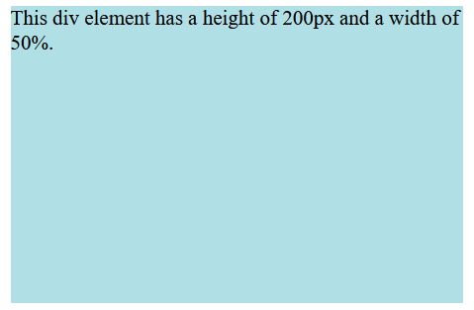
Example
div {
height: 200px;
width: 50%;
background-color: powderblue;
}

Slide 15
The max-width property is used to set the maximum width of an element.
The max-width can be specified in length values, like px, cm, etc., or in percent (%) of the containing block,
The problem with the <div> occurs when the browser window is smaller than the width of the element (500px). The browser then adds a horizontal scrollbar to the page.
Using max-width instead, in this situation, will improve the browser's handling of small windows.

Slide 16
Example
div {
max-width: 500px;
height: 100px;
background-color: powderblue;
}

Slide 17
Padding & Margin
CSS Padding
The CSS padding properties are used to generate space around an element's content, inside of any defined borders.
There are properties for setting the padding for each side of an element (top, right, bottom, and left).
Padding - Individual Sides

Slide 18
CSS has properties for specifying the padding for each side of an element:
padding-top
padding-right
padding-bottom
padding-left

Slide 19
All the padding properties can have the following values:
length - specifies a padding in px, pt, cm, etc.
% - specifies a padding in % of the width of the containing element
inherit - specifies that the padding should be inherited from the parent element
Negative values are not allowed

Slide 20
<!DOCTYPE html>
<html>
<head>
<style>
div {
border: 1px solid black;
background-color: lightblue;
padding-top: 50px;
padding-right: 30px;
padding-bottom: 50px;
padding-left: 80px;
}
</style>
</head>
<body>
<h2>Using individual padding properties</h2>
<div>This div element has a top padding of 50px, a right padding of 30px, a bottom padding of 50px, and a left padding of 80px.</div>
</body>
</html>

Slide 21
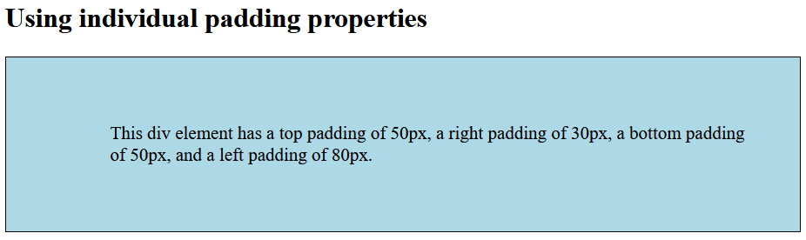

Slide 22
CSS Margins
The CSS margin properties are used to create space around elements, outside of any defined borders.
There are properties for setting the margin for each side of an element (top, right, bottom, and left).
Margin - Individual Sides

Slide 23
CSS has properties for specifying the margin for each side of an element:
margin-top
margin-right
margin-bottom
margin-left

Slide 24
All the margin properties can have the following values:
auto - the browser calculates the margin
length - specifies a margin in px, pt, cm, etc.
% - specifies a margin in % of the width of the containing element
inherit - specifies that the margin should be inherited from the parent element
Negative values are allowed.

Slide 25
<!DOCTYPE html>
<html>
<head>
<style>
div {
border: 1px solid black;
margin-top: 100px;
margin-bottom: 100px;
margin-right: 150px;
margin-left: 80px;
background-color: lightblue;
}
</style>
</head>
<body>
<h2>Using individual margin properties</h2>
<div>This div element has a top margin of 100px, a right margin of 150px, a bottom margin of 100px, and a left margin of 80px.</div>
</body>
</html>

Slide 26
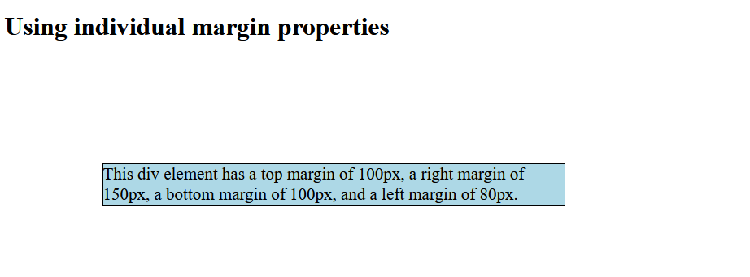

Slide 27
To shorten the code, it is possible to specify all the margin properties in one property.
If the margin property has four values:
margin: 25px 50px 75px 100px;
If the margin property has three values:
margin: 25px 50px 75px;
Top Right Bottom Left
Top Left & Right Bottom

Slide 28
If the margin property has two values:
margin: 25px 50px;
If the margin property has one value:
margin: 25px;
Top & Bottom Right & Left
All four sides equal margin

Slide 29
Border Property
The border property is a shorthand property for the following individual border properties:
border-width
border-style (required)
border-color
Border Style
The border-style property specifies what kind of border to display.

Slide 30
The following values are allowed:
dotted - Defines a dotted border
dashed - Defines a dashed border
solid - Defines a solid border
double - Defines a double border
groove - Defines a 3D grooved border
ridge - Defines a 3D ridged border
inset - Defines a 3D inset border
outset - Defines a 3D outset border
none - Defines no border
hidden - Defines a hidden border

Slide 31
The border-style property can have from one to four values (for the top border, right border, bottom border, and the left border).
Border Width
The border-width property specifies the width of the four borders.
The width can be set as a specific size (in px, pt, cm, em, etc) or by using one of the three pre-defined values: thin, medium, or thick.

Slide 32
Border color
The border-color property is used to set the color of the four borders.
The color can be set by:
name - specify a color name, like "red"
HEX - specify a HEX value, like "#ff0000"
RGB - specify a RGB value, like "rgb(255,0,0)"
HSL - specify a HSL value, like "hsl(0, 100%, 50%)"
transparent
Note: If border-color is not set, it inherits the color of the element.

Slide 33
CSS Rounded Borders
The border-radius property is used to add rounded borders to an element:
p {
border: 2px solid red;
border-radius: 5px;
}

Slide 34
<!DOCTYPE html>
<html>
<head>
<style>
p.normal {
border: 2px solid red;
}
p.round1 {
border: 2px solid red;
border-radius: 5px;
}
p.round2 {
border: 2px solid red;
border-radius: 8px;
}
​
p.round3 {
border: 2px solid red;
border-radius: 12px;
}
</style>
</head>

Slide 35
<body>
<h2>The border-radius Property</h2>
<p>This property is used to add rounded borders to an element:</p>
<p class="normal">Normal border</p>
<p class="round1">Round border</p>
<p class="round2">Rounder border</p>
<p class="round3">Roundest border</p>
</body>
</html>
​

Slide 36
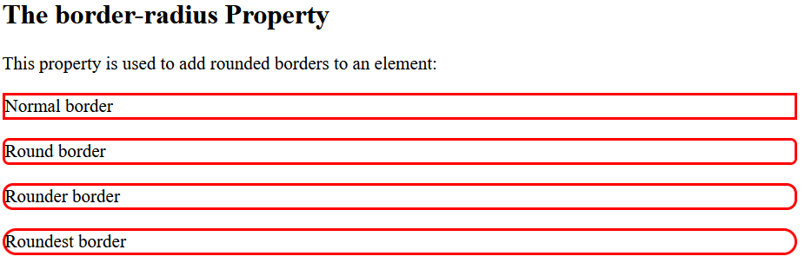

Slide 37
References
https://www.w3schools.com/css/default.asp
https://developer.mozilla.org/en-US/docs/Web/CSS

